Slide 1
Queues
Revised 2019

Slide 2
Learning Outcomes
After the completion of this class, student should be able to:
Describe the access strategy of Queues
Relate lists to queues
Create structures or objects as items being managed by a queue access
Construct applications that employs queue as ADT
2

Slide 3
Scope
Queues
Queue Implementations
Using an Array
Circular Array
Using a Linked List
Queues Analysis (Complexity Analysis)
As Array
As Circular Array
As Linked List
3

Slide 4
Queues
A queue is a collection where elements are added to one end and removed from the other
A queue is managed in a FIFO fashion: first in, first out
Elements are removed in the same order they arrive
Any waiting line is a queue:
the check out line at a grocery store
the cars at a stop light
an assembly line
4

Slide 5
Conceptual View of a Queue
Front of queue
Rear of queue
5

Slide 6
Conceptual View of a Queue
Front of queue
Rear of queue
New element is added to the rear of the queue
6

Slide 7
Conceptual View of a Queue
New front element of queue
Rear of queue
Element is removed from the front of the queue
7

Slide 8
Uses of Queues in Computing
Many application requires FIFO-access of data
Printer queue (e.g. printing requests)
Keyboard input buffer
GUI event queue (click on buttons, menu items)
Process scheduling in Operating Systems
8

Slide 9
Queue ADT
A queue, conceptually:
9

Slide 10
Queues Operations
Standard queue operations: some changes the state of the queue and others just observe the current queue status
It is not legal to access the elements in the middle of the queue!
10

Slide 11
Queues in the Java API
For queues, the Java Collections API provides a Queue interface, then various classes such as LinkedList implement the interface
Furthermore, the Queue interface defines two versions of the methods that add and remove elements from the queue
The difference in the two versions is how exceptional situations are handled
11

Slide 12
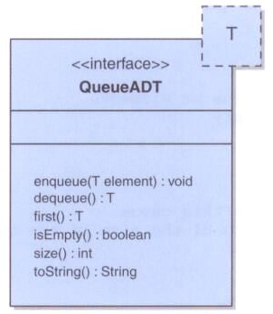
A Queue ADT
Defining an interface for a queue, using only basic queue operations:
public interface QueueADT<T>
{
public void enqueue(T element);
public T dequeue();
public T first();
public boolean isEmpty();
public int size();
public String toString();
}
12

Slide 13
Queue Implementations
We have three implementations for a Queue
QueueAsArray
QueueAsCircularArray
QueueAsLinkedList
13

Slide 14
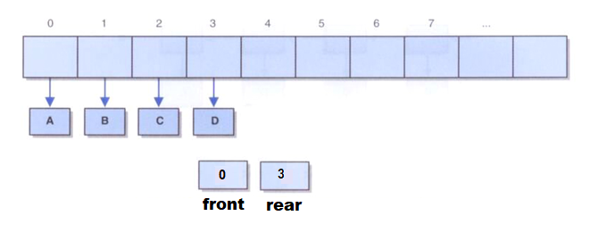
Implementing a Queue with a simple Array
We can use an array to implement a queue
A queue operates at two ends. To be efficient, we must avoid shifting elements
Note that you have to decide how you will implement the rear pointer
Pointing at the last element entered
Pointing at the next free position
14

Slide 15
Implementing a Queue with a simple Array (CONT.)
Notice that r is holding the index of the next available position in the queue
Example
0
1
2
3
4
f = 0
Queue x
Queue
r = 0
f
r
0
1
2
3
4
f = 0
x.enqueue (5)
Queue
5
r = 1
f
r
0
1
2
3
4
f = 0
x.enqueue (8)
Queue
5
8
f
r
r = 2
0
1
2
3
4
f = 0
x.enqueue (2)
Queue
5
8
2
f
r
r = 3
0
1
2
3
4
f = 1
y = x.dequeue ()
Queue
8
2
f
r
r = 3
0
1
2
3
4
f = 1
x.enqueue (9)
Queue
8
2
9
f
r
r = 4
15

Slide 16
Discussion
The initialization value of the rear!
What if the queue is empty?
What if there is only 1 element?
What if the queue is full?
What about the order of the operations in dequeue() and enqueue()?
16
Notes:
queue is empty: count =0, front=rear=null
only 1 element: front = rear

Slide 17
Implementing a Queue with a simple Array (CONT.)
Enqueue/Dequeue Operations-
Be aware of special cases to handle the value of rear!
How to detect when the array is full (or empty)?
An element may be in the last index of the array, however, the queue may not be full!
Should resize the array?
Using SIMPLE ARRAY
isFull() | enqueue ()
public boolean isFull( ){ if((rear+1) == size) return true; return false; } | /* rear holds the index of the last item in the queue */ public void enqueue(int x){ if( !isFull( ) ) values[++rear] = x; }
isEmpty() | dequeue ()
public boolean isEmpty( ){ return(rear == front) } /* what do you think of the condition above? what do you recommend? */ | public int dequeue( ){ if( ! isEmpty( ) ) return values[front++]; return 0; }
17
17

Slide 18
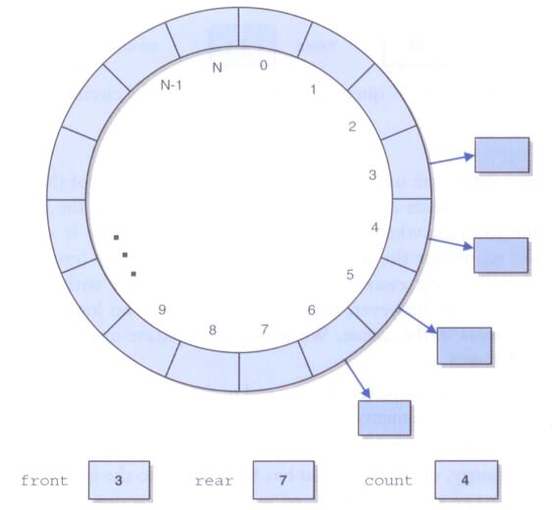
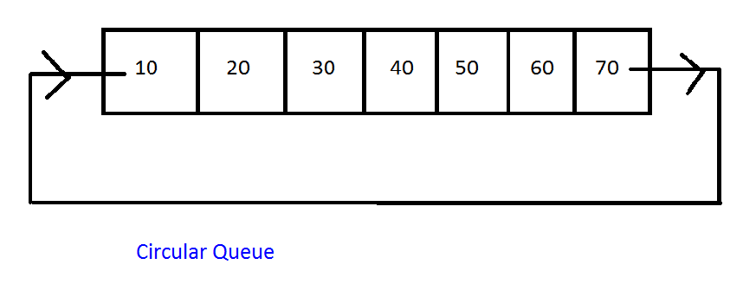
Implementing a Queue with an Array
A better solution is to treat the array as circular
A circular array is a regular array that is treated as if it loops back on itself
The last index is thought to precede index 0
18

Slide 19
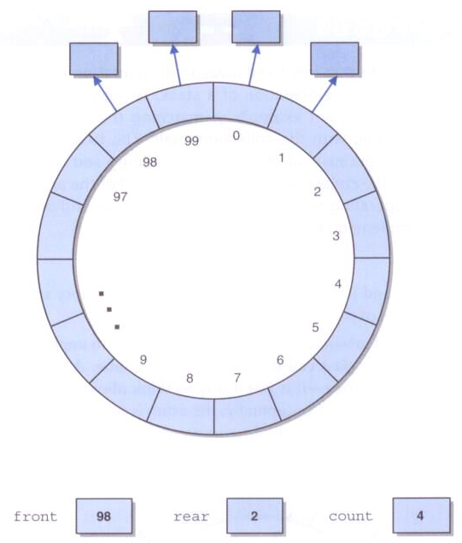
Implementing a Queue with a circular Array
At some point, the elements of the queue may straddle the end of the array, that is, rear comes before front
rear index is less than front index
19

Slide 20
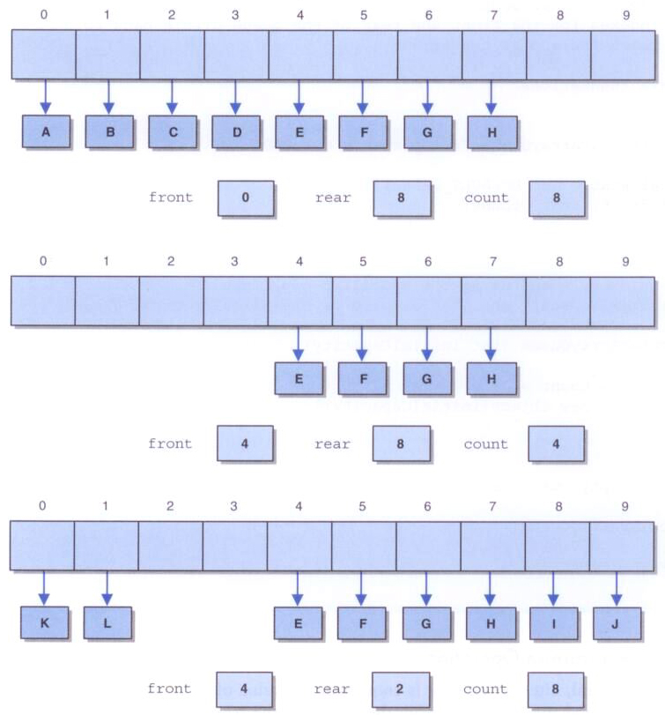
Implementing a Queue with a circular Array (CONT.)
After A-H have been enqueued:
After A-D have been dequeued:
After I, J, K, and L have been enqueued:
20

Slide 21
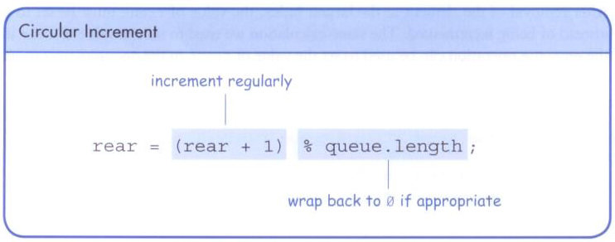
Implementing a Queue with an Array (CONT.)
By using modulo arithmetic for computing array indices, we can have a queue implementation in which each of the operations enqueue, dequeue, and checking front has complexity O(1).
Both the front and rear indices are incremented, wrapping back to 0 when necessary
21

Slide 22
Implementing a Queue with a Circular Array (CONT.)
Enqueue/Dequeue Operations
isFull() | enqueue ()
/* rear holds the index of the next position to use in the queue */ public boolean isFull( ){ return ((rear+1)%size == front); } | public void enqueue(int x){ if( !isFull( ) ){ values[rear] = x; rear = (rear+1) % size; } }
Using CIRCULAR ARRAY
isEmpty() | dequeue ()
public boolean isEmpty( ){ return(rear == front) } /* what do you think of the condition above? */ | public int dequeue( ){ if( ! isEmpty( ) ){ int e = values[front]; front = (front+1)% size; return e; } return 0; }
22

Slide 23
LinkedList Implementation of a Queue
A queue q containing four elements
head
tail
rear
q
front
4
count
23

Slide 24
Queue After eNqueue operatopn
The new element, , is added in a node at the end of the list, rear points to the new node, and count is incremented
head
tail
rear
q
front
5
count
24

Slide 25
Queue After a dequeue Operation
Node containing is removed from the front of the list (see previous slide), front now points to the node that was formerly second, and count has been decremented.
head
tail
rear
q
front
4
count
25

Slide 26
Java Implementation
The queue is represented as a linked list of nodes:
We may use the Node class or either the SLL or DLL class
If front is a reference to the head of the queue (beginning of the linked list) then rear is a reference to the tail of the queue (end of the linked list)
If front is a reference to the tail of the queue (end of the linked list) then rear is a reference the head of the queue (beginning of the linked list)
The integer count is the number of nodes in the queue
Implementation: in-class activity
Discussion:
What is the complexity of all operations if a tail pointer exists?
What is the complexity of all operations if a tail pointer does not exist?
26

Slide 27
Stack VS. Queue
enqueue
dequeue
pop
push
Stack – a LIFO structure (last in, first out)
Queue – a FIFO structure (first in, first out)
27

Slide 28
Priority Queues
In a normal queue, the enqueue operation adds an item at the back of the queue, and the dequeue operation removes an item at the front of the queue.
In priority queues, elements are dequeued according to their priority and their current queue position.
A higher priority item is always processed before a lower priority element.
The problem with a priority queue is finding an efficient implementation that allows relatively fast enqueuing and dequeuing. Because elements may arrive randomly to the queue, there is no guarantee that the front elements will be the most likely to be dequeued and that the elements put at the end will be the last candidates for dequeuing.
28

Slide 29
Priority Queues (CONT.)
Priority queues can be represented by two variations of linked lists.
In one type of linked list, all elements are entry ordered, and in another, order is maintained by putting a new element in its proper position according to its priority.
In both cases, the total operational times are O(n) because, for an unordered list, adding an element is immediate but searching is O(n), and in a sorted list, taking an element is immediate but adding an element is O(n).
29

Slide 30
Appendix I: Queues Analysis
- Complexity Analysis -
Note: some ideas in this section are repeated in another way, or another representation way
Both are doing the same operation
30

Slide 31
Queue As Array
public class QueueAsArray extends AbstractContainer
implements Queue {
protected Object[] array;
protected int rear = 0;
protected int size;
public QueueAsArray(int size) {
array = new Object[size];
this.size = size;
}
public Object getFront(){
if(count == 0)
throw new ContainerEmptyException();
else
return array[0];
}
Complexity is O(1)
31

Slide 32
Queue As Array (Cont.)
public void enqueue(Object obj){
if(count == size){
throw new ContainerFullException();
}
else{
array[rear++] = obj;
count++;
}
}
Complexity is O(1)
32

Slide 33
Queue As Array (Cont.)
public Object dequeue(){
if(count == 0)
throw new ContainerEmptyException();
else
{
Object obj = array[0];
count--;
for(int k = 1; k <= count; k++)
array[k - 1] = array[k];
rear--;
return obj;
}
}
Complexity is O(n)
33

Slide 34
Queue As Circular Array
public class QueueAsCircularArray extends AbstractContainer
implements Queue {
protected Object[] array;
protected int front = 0;
protected int rear = 0;
protected int size;
public QueueAsCircularArray(int size) {
array = new Object[size]; this.size = size;
}
public Object getHead(){
if(count == 0) throw new ContainerEmptyException();
else return array[front];
}
Complexity is O(1)
34

Slide 35
Queue As Circular Array (Cont.)
public void enqueue(Object obj){
if(count == size) throw new ContainerFullException();
else {
array[rear] = obj;
rear = (rear + 1) % size;
count++;
}
}
public Object dequeue(){
if(count == 0)throw new ContainerEmptyException();
else {
Object obj = array[front];
front = (front + 1) % size;
count--;
return obj;
}
}
Complexity is O(1)
Complexity is O(1)
35

Slide 36
Queue As LinkedList
public class QueueAsLinkedList extends AbstractContainer
implements Queue {
protected MyLinkedList list;
public QueueAsLinkedList(){list = new MyLinkedList();}
public Object getFront(){
if(count == 0)
throw new ContainerEmptyException();
else
return list.getFirst();
}
Complexity is O(1)
36

Slide 37
Queue As LinkedList (cont.)
public void enqueue(Object obj){
list.append(obj);
count++;
}
public Object dequeue(){
if(count == 0)
throw new ContainerEmptyException();
else {
Object obj = list.getFirst();
list.extractFirst();
count--;
return obj;
}
}
Complexity is O(1)
Complexity is O(1)
37

Slide 38
Summary
Queue, and Stacks, are Abstract Data Types that may be implemented using arrays, linked lists and even other ADTs- stack implementation using queues and vice versa.
Queue elements are processed in a FIFO manner—the first element in is the first element out.
Simulations are often implemented using queues to represent waiting lines.
A linked implementation of a queue is facilitated by references to the first and last elements of the linked list.
The enqueue and dequeue operations work on opposite ends of the collection.
Because queue operations modify both ends of the collection, fixing one end at index 0 requires that elements be shifted.
Treating arrays as circular eliminates the need to shift elements in an array queue implementation.
A priority queue is a queue in which elements are dequeued according to their priority .
In both suggested implementations, enqueuing and dequeuing can be executed in constant time O(1). In the doubly linked list implementation, it can be done in O(1) time.
The shifting of elements in a noncircular array implementation creates an O(n) complexity.
38

Slide 39
References
Java Software Structures - Designing and Using Data Structures, 4th edition, Lewis and Chase.
Data Structures & Algorithms in Java, 3rd edition,
Algorithms, 4th edition, Sedgewick and Wayne.
Data Structures and Algorithms in Java, 6th edition, Goodrich, Tamassia and Goldwasser.
Slides at: http://faculty.kfupm.edu.sa/ICS/jauhar/ics202/
39

Slide 40
Any Question???

