Slide 1
Algorithms and Data Structures (CS211)
Instructor
Modhi AlSobeihy
Revised 2021

Slide 2
Welcome!
Get a copy of lecture slides and review it before class time
Create an area dedicated to studying
Give yourself a break from social media
Give Gratitude and Think Positive Thoughts
Boast about your achievements
Make sure you have support
Schedule in your studying
Contact the class leader if you are having any issue

Slide 3
Course Objectives
Be familiar with problem solving
Be able to develop and implement algorithms
Be able to trace algorithms
Be able to select appropriate data structures and algorithms for given problems

Slide 4
Course Learning Outcomes
After the completion of this course, students shall be able to:
apply object-oriented concepts in application design.
implement various data structures and relevant algorithms and apply them in implementing simple applications.
apply the knowledge of data structures to other application domains like Graphs, Trees and Hashing.

Slide 5
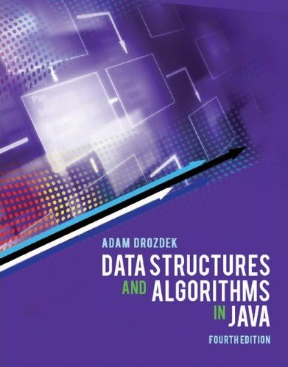
Textbook
Textbook:
Data Structures and Algorithms
in Java, Adam Drozdek, 4th ed.
Alternative:
Any textbook that covers course topics

Slide 6
Schedules & Assessment system
Assignments and lab tutorials
Concept discussion
Programming projects
Work in teams only on explicit team projects
Discuss on time
Grading
Mid-terms (30%)& Quizzes (5%)
Quizzes: every class!
Exam1:Week 6 or 7 of the semester
Exam2: Week 12 or13 of the semester
Lab work/Homework (10%)
Practical Tests (5%)
Final Project(10%)
Final Exam (theoretical) (40%)

Slide 7
Course website and communication
Twitter account for announcements, quick reviews and teasers) @cs_course_at_tu
Website: https://sites.google.com/view/cs211-tu/home
Blackboard

Slide 8
Java IDE (Integrated Development Environment
Netbeans for Java SE
http://netbeans.org/downloads/
Eclipse for Java
https://www.eclipse.org/downloads/?

Slide 9
Weekly Plan of Course Items and Activities (tentative)
N | Topics
1 | Introduction to algorithms and data structures & Complexity Analysis
2 | Recursion
3 | Linked Lists
4 | First Midterm Exam
5 | Stacks and Queues

Slide 10
Weekly Plan of Course Items and Activities (tentative)
N | Topic
6 | Trees & Graphs
7 | Second Midterm Exam
8 | Sorting & Searching
9 | Hash Tables
10 | Summarizing
11 | Final Exam
10

Slide 11
Any Question???

