Slide 1
Chapter 14: File System Implementation

Slide 2
Outline
File-System Structure
File-System Operations
Directory Implementation
Allocation Methods
Free-Space Management
Performance and Recovery

Slide 3
Objectives
Describe the details of implementing local file systems and directory structures
Discuss block allocation and free-block algorithms and trade-offs
Explore file system efficiency and performance issues
Look at recovery from file system failures
Describe the WAFL file system as a concrete example

Slide 4
File-System Structure
File structure
  Logical storage unit
  Collection of related information
File system resides on secondary storage (disks)
  Provided user interface to storage, mapping logical to physical
  Provides efficient and convenient access to disk by allowing data to be stored, located retrieved easily
Disk provides in-place rewrite and random access
  I/O transfers performed in blocks of sectors (usually 512 bytes)
File control block (FCB) – storage structure consisting of information about a file
Device driver controls the physical device
File system organized into layers

Slide 5
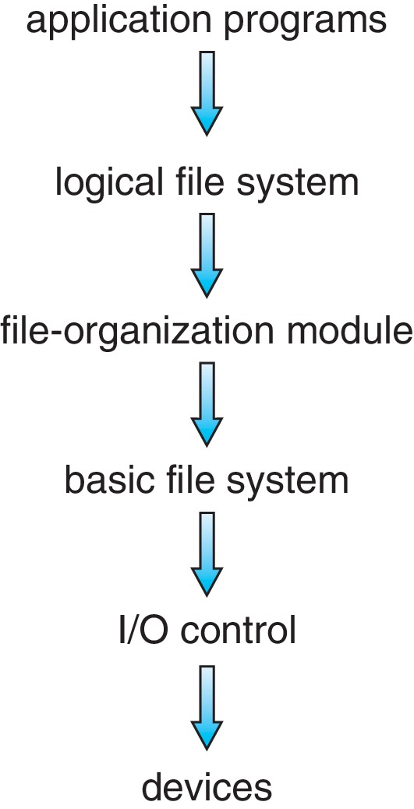
Layered File System

Slide 6
File System Layers
Device drivers manage I/O devices at the I/O control layer
  Given commands like
  read drive1, cylinder 72, track 2, sector 10, into memory location 1060
  Outputs low-level hardware specific commands to hardware controller
Basic file system given command like “retrieve block 123” translates to device driver
Also manages memory buffers and caches (allocation, freeing, replacement)
  Buffers hold data in transit
  Caches hold frequently used data
File organization module understands files, logical address, and physical blocks
  Translates logical block # to physical block #
  Manages free space, disk allocation

Slide 7
File System Layers (Cont.)
Logical file system manages metadata information
  Translates file name into file number, file handle, location by maintaining file control blocks (inodes in UNIX)
  Directory management
  Protection
Layering useful for reducing complexity and redundancy, but adds overhead and can decrease performance
Logical layers can be implemented by any coding method according to OS designer

Slide 8
File System Layers (Cont.)
Many file systems, sometimes many within an operating system
  Each with its own format:
  CD-ROM is ISO 9660;
  Unix has UFS, FFS;
  Windows has FAT, FAT32, NTFS as well as floppy, CD, DVD Blu-ray,
  Linux has more than 130 types, with extended file system ext3 and ext4 leading; plus distributed file systems, etc.)
  New ones still arriving – ZFS, GoogleFS, Oracle ASM, FUSE

Slide 9
File-System Operations
We have system calls at the API level, but how do we implement their functions?
  On-disk and in-memory structures
Boot control block contains info needed by system to boot OS from that volume
  Needed if volume contains OS, usually first block of volume
Volume control block (superblock, master file table) contains volume details
  Total # of blocks, # of free blocks, block size, free block pointers or array
Directory structure organizes the files
  Names and inode numbers, master file table

Slide 10
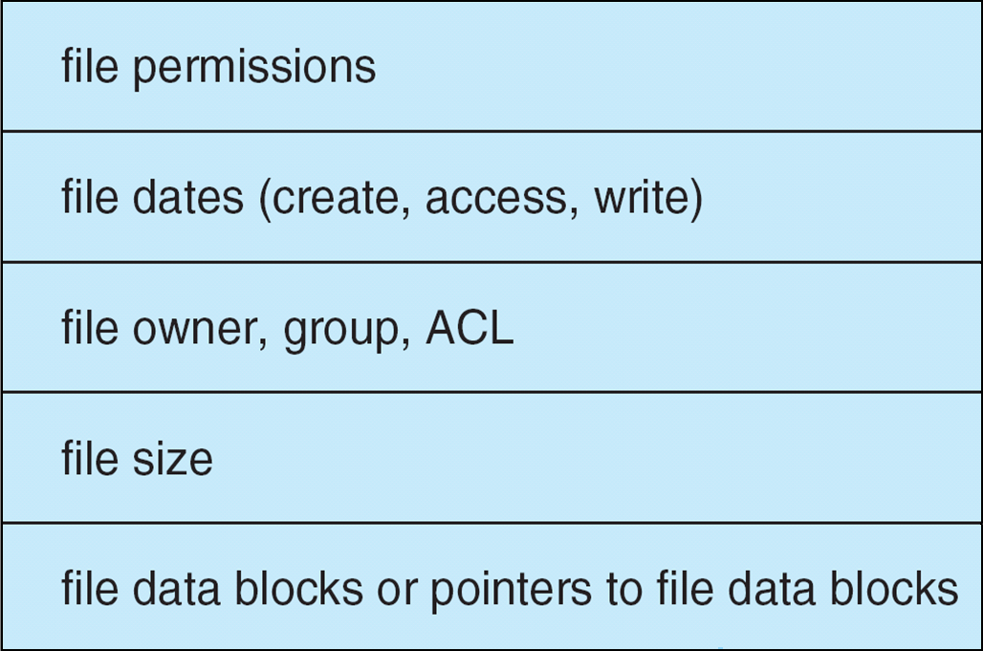
File Control Block (FCB)
OS maintains FCB per file, which contains many details about the file
  Typically, inode number, permissions, size, dates
  Example

Slide 11
In-Memory File System Structures
Mount table storing file system mounts, mount points, file system types
System-wide open-file table contains a copy of the FCB of each file and other info
Per-process open-file table contains pointers to appropriate entries in system-wide open-file table as well as other info

Slide 12
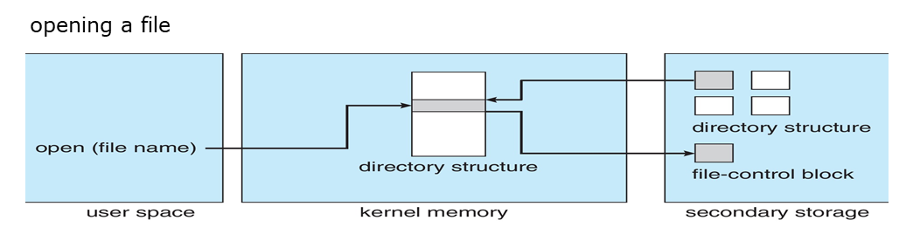
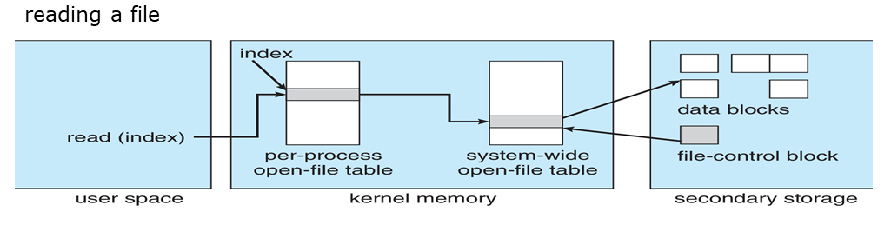
In-Memory File System Structures (Cont.)

Slide 13
Directory Implementation
Linear list of file names with pointer to the data blocks
  Simple to program
  Time-consuming to execute
    Linear search time
    Could keep ordered alphabetically via linked list or use B+ tree
Hash Table – linear list with hash data structure
  Decreases directory search time
  Collisions – situations where two file names hash to the same location
  Only good if entries are fixed size, or use chained-overflow method

Slide 14
Allocation Method
An allocation method refers to how disk blocks are allocated for files:
  Contiguous
  Linked
  File Allocation Table (FAT)

Slide 15
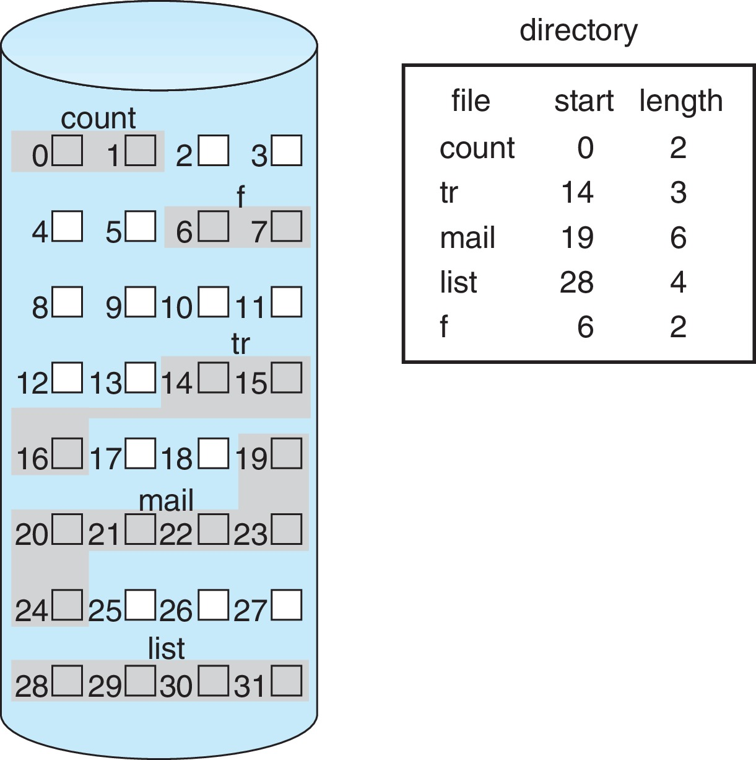
Contiguous Allocation Method
An allocation method refers to how disk blocks are allocated for files:
Each file occupies set of contiguous blocks
  Best performance in most cases
  Simple – only starting location (block #) and length (number of blocks) are required
  Problems include:
    Finding space on the disk for a file,
    Knowing file size,
    External fragmentation, need for compaction off-line (downtime) or on-line

Slide 16
Extent-Based Systems
Many newer file systems (i.e., Veritas File System) use a modified contiguous allocation scheme
Extent-based file systems allocate disk blocks in extents
An extent is a contiguous block of disks
  Extents are allocated for file allocation
  A file consists of one or more extents

Slide 17
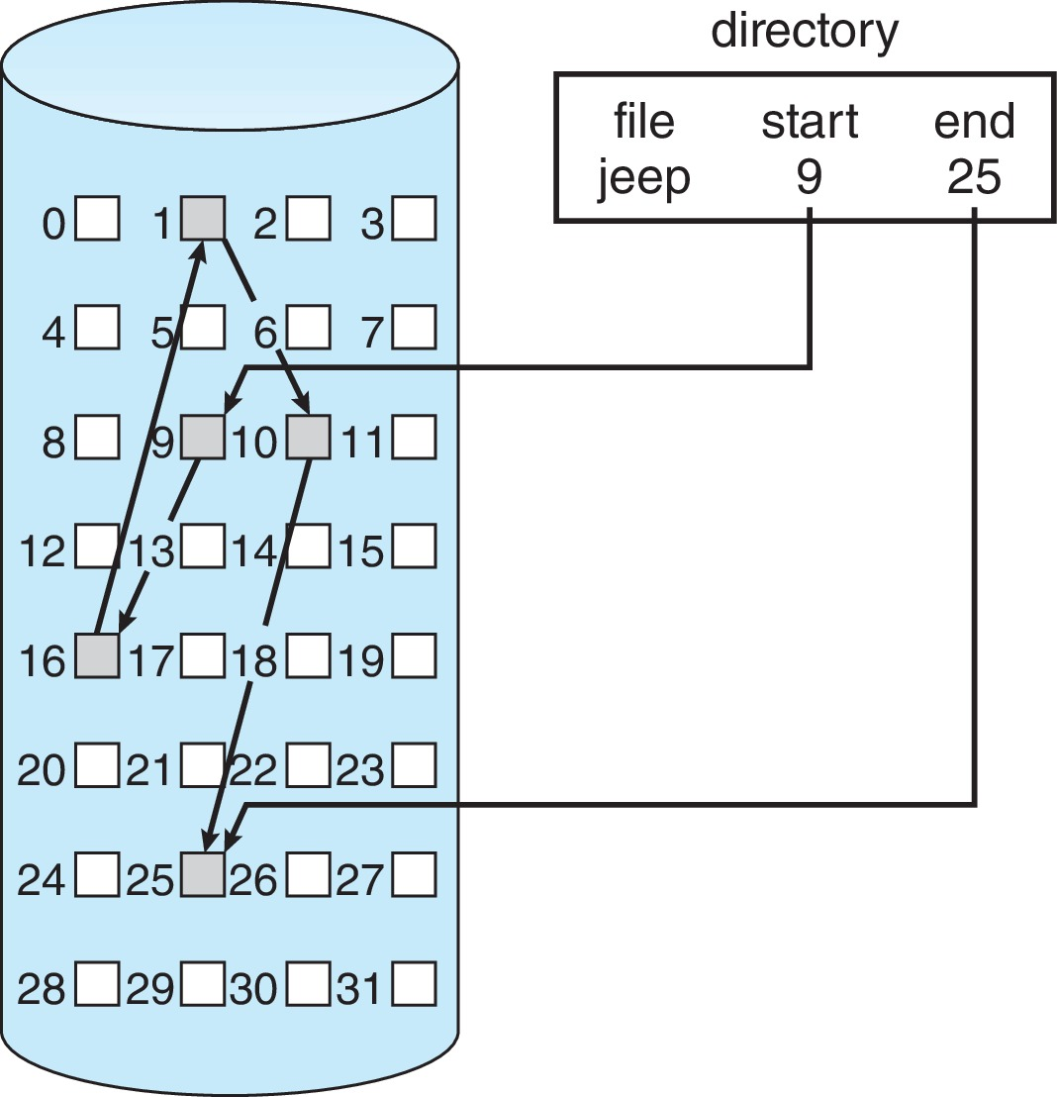
Linked Allocation
Each file is a linked list of blocks
File ends at nil pointer
No external fragmentation
Each block contains pointer to next block
No compaction, external fragmentation
Free space management system called when new block needed
Improve efficiency by clustering blocks into groups but increases internal fragmentation
Reliability can be a problem
Locating a block can take many I/Os and disk seeks

Slide 18
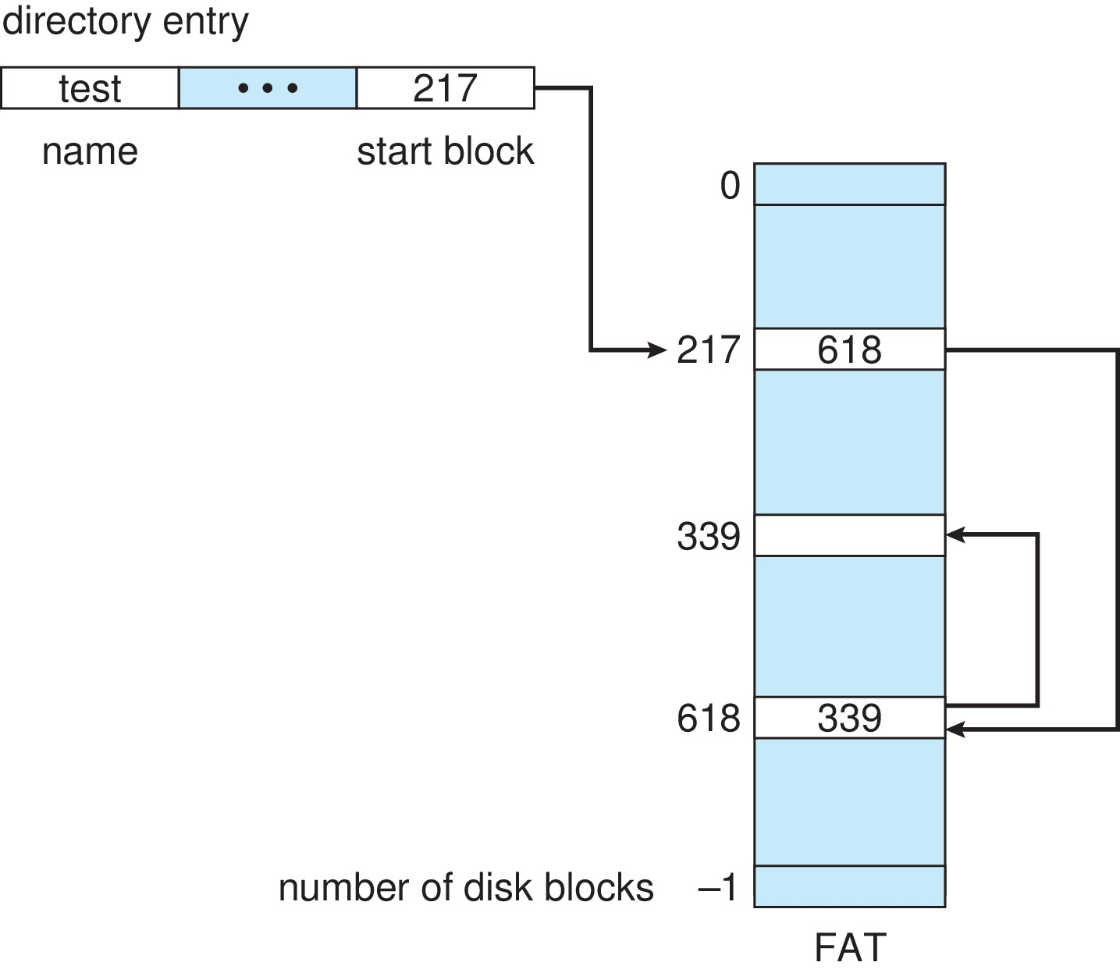
FAT Allocation Method
Beginning of volume has table, indexed by block number
Much like a linked list, but faster on disk and cacheable
New block allocation simple

Slide 19
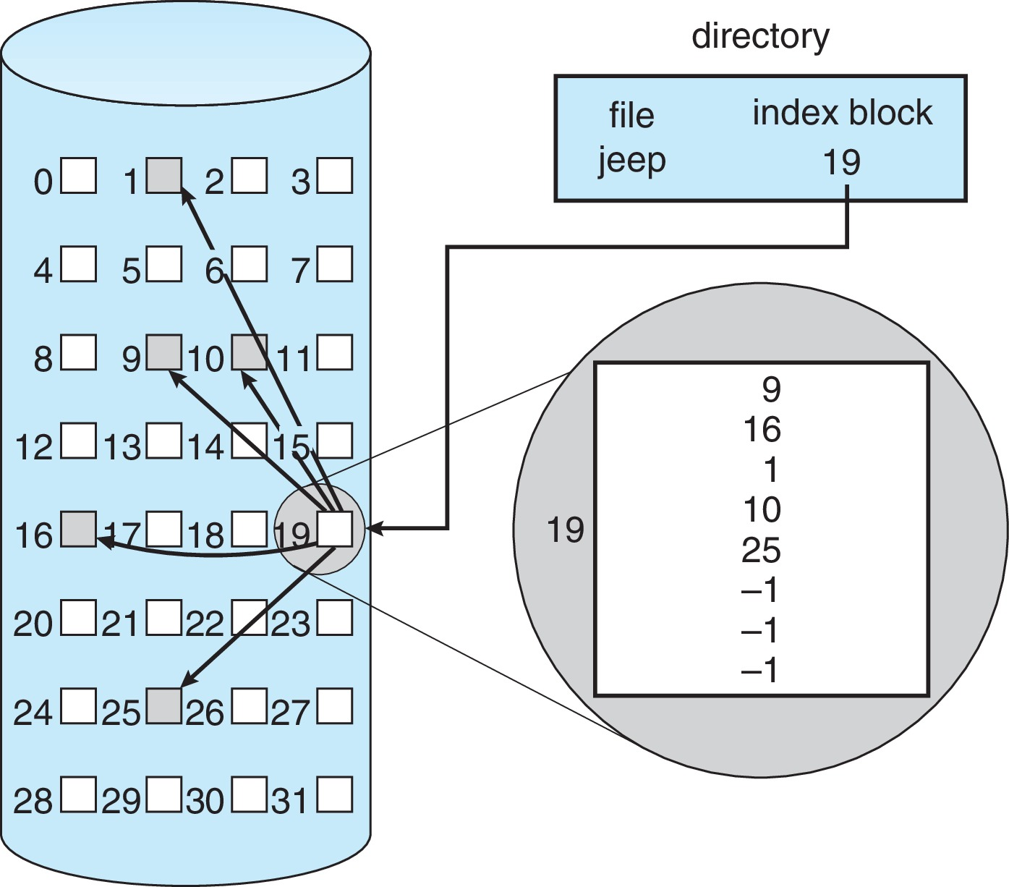
Indexed Allocation Method
Each file has its own index block(s) of pointers to its data blocks
Logical view

Slide 20
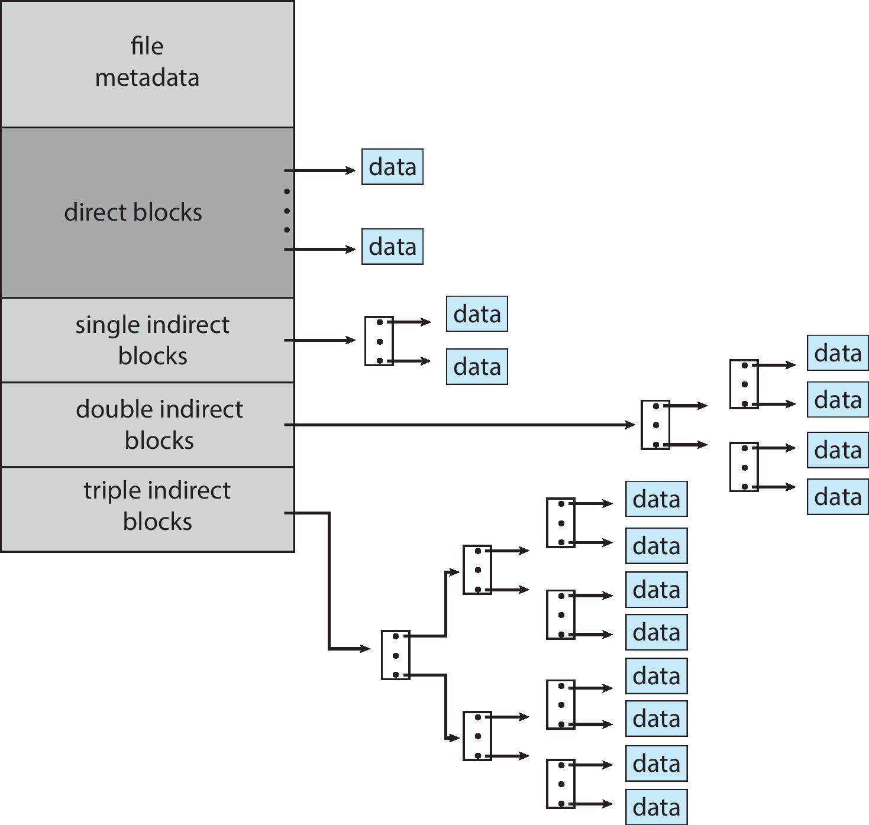
Combined Scheme : UNIX UFS
4K bytes per block, 32-bit addresses
More index blocks than can be addressed with 32-bit file pointer

Slide 21
Performance
Best method depends on file access type
  Contiguous great for sequential and random
Linked good for sequential, not random
Declare access type at creation
  Select either contiguous or linked
Indexed more complex
  Single block access could require 2 index block reads then data block read
  Clustering can help improve throughput, reduce CPU overhead
For NVM, no disk head so different algorithms and optimizations needed
  Using old algorithm uses many CPU cycles trying to avoid non-existent head movement
  Goal is to reduce CPU cycles and overall path needed for I/O

Slide 22
Free-Space Management
File system maintains free-space list to track available blocks
Bit vector or bit map (n blocks)
Bit map requires extra space
Block number calculation: (number of bits per word) *(number of 0-value words) + offset of first 1 bit
  CPUs have instructions to return offset within word of first “1” bit
For example, consider a disk where blocks 2, 3, 4, 5, 8, 9, 10, 11, 12, 13, 17, 18, 25, 26, and 27 are free and the rest of the blocks are allocated.
  The free-space bitmap would be 001111001111110001100000011100000
Easy to get contiguous files
0
1
2
n-1
…
1 ⇒ block[i] free
0 ⇒ block[i] occupied

bit[i] =

Slide 23
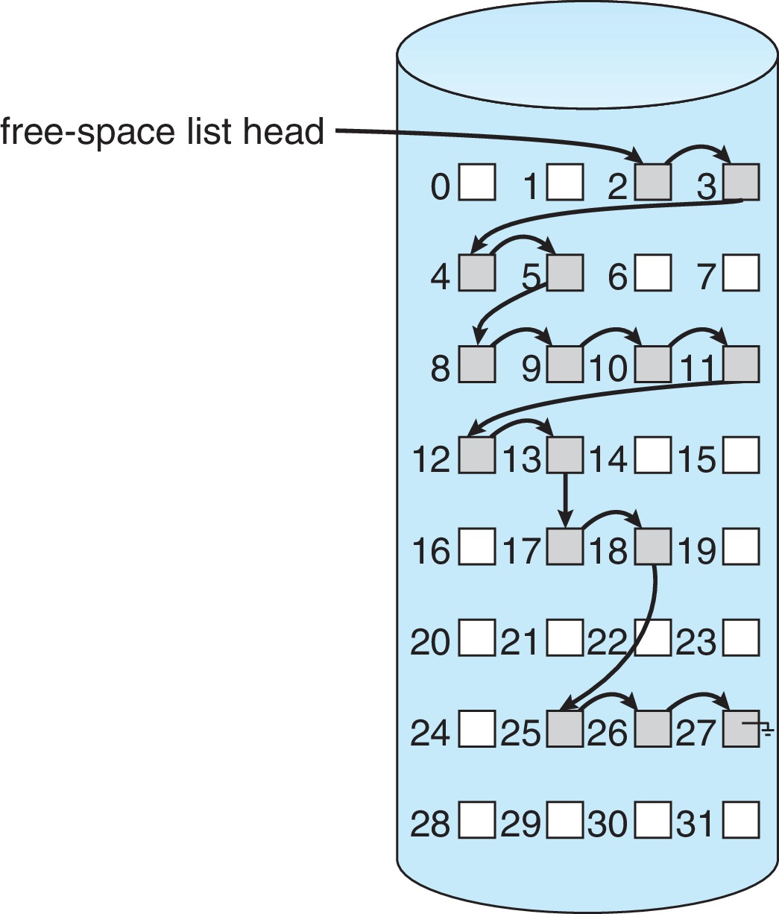
Linked Free Space List
Linked list (free list)
  Cannot get contiguous space easily
  No waste. Linked Free Space List on Disk of space
  No need to traverse the entire list (if # free blocks recorded)
Example:
  Blocks 2, 3, 4, 5, 8, 9, 10, 11, 12, 13, 17, 18, 25, 26, and 27 are free in the figure on the right

Slide 24
Free-Space Management (Cont.)
Grouping
  Modify linked list to store address of next n-1 free blocks in first free block, plus a pointer to next block that contains free-block-pointers (like this one)
Counting
  Because space is frequently contiguously used and freed, with contiguous-allocation allocation, extents, or clustering
    Keep address of first free block and count of following free blocks
    Free space list then has entries containing addresses and counts

Slide 25
Free-Space Management (Cont.)
Space Maps
  Used in ZFS
  Consider meta-data I/O on very large file systems
    Full data structures like bit maps cannot fit in memory ➔ thousands of I/Os
  Divides device space into metaslab units and manages metaslabs
    Given volume can contain hundreds of metaslabs
  Each metaslab has associated space map
    Uses counting algorithm
  But records to log file rather than file system
    Log of all block activity, in time order, in counting format
  Metaslab activity ➔ load space map into memory in balanced-tree structure, indexed by offset
    Replay log into that structure
    Combine contiguous free blocks into single entry

Slide 26
Efficiency and Performance
Efficiency dependent on:
  Disk allocation and directory algorithms
  Types of data kept in file’s directory entry
  Pre-allocation or as-needed allocation of metadata structures
  Fixed-size or varying-size data structures

Slide 27
Efficiency and Performance (Cont.)
Performance
  Keeping data and metadata close together
  Buffer cache – separate section of main memory for frequently used blocks
  Synchronous writes sometimes requested by apps or needed by OS
    No buffering / caching – writes must hit disk before acknowledgement
    Asynchronous writes more common, buffer-able, faster
  Free-behind and read-ahead – techniques to optimize sequential access
  Reads frequently slower than writes

Slide 28
Recovery
Consistency checking – compares data in directory structure with data blocks on disk, and tries to fix inconsistencies
  Can be slow and sometimes fails
Use system programs to back up data from disk to another storage device (magnetic tape, other magnetic disk, optical)
Recover lost file or disk by restoring data from backup

Slide 29
End of Chapter 14

