Slide 1
UNIT
Introduction to Prolog
Lecture 3:
Recursion And Lists

Slide 2
Introduction to Prolog
Teaching Material
Learn Prolog Now!
http://lpn.swi-prolog.org/lpnpage.php?pageid=top
SWI Prolog interpreter
http://www.swi-prolog.org/
Knowledge bases code available at http://l3s.de/~gaugaz/ki/prolog/

Slide 3
Lecture 3: Recursion
Theory
Introduce recursive definitions in Prolog
Four examples
Show that there can be mismatches between the declarative and procedural meaning of a Prolog program
Exercises
Corrections exercises LPN chapter 2
Exercises of LPN chapter 3

Slide 4
Recursive Definitions
Prolog predicates can be defined recursively
A predicate is recursively defined if one or more rules in its definition refers to itself
Example 1: Eating
isDigesting(X,Y):- justAte(X,Y).
isDigesting(X,Y):- justAte(X,Z), isDigesting(Z,Y).
justAte(mosquito,blood(john)).
justAte(frog,mosquito).
justAte(stork,frog).
?-

Slide 5
Picture of the situation
justAte
X
Y
isDigesting
justAte
isDigesting
X
Z
Y
isDigesting

Slide 6
Example 1: Eating
isDigesting(X,Y):- justAte(X,Y).
isDigesting(X,Y):- justAte(X,Z), isDigesting(Z,Y).
justAte(mosquito,blood(john)).
justAte(frog,mosquito).
justAte(stork,frog).
?- isDigesting(stork,mosquito).
Another recursive definition
p:- p.
?- p.
ERROR: out of memory

Slide 7
Example 2: Decendant
child(bridget,caroline).
child(caroline,donna).
descend(X,Y):- child(X,Y).
descend(X,Y):- child(X,Z), child(Z,Y).
child(anna,bridget).
child(bridget,caroline).
child(caroline,donna).
child(donna,emily).
descend(X,Y):- child(X,Y).
descend(X,Y):- child(X,Z), child(Z,Y).

Slide 8
Example 2: Decendant
child(anna,bridget).
child(bridget,caroline).
child(caroline,donna).
child(donna,emily).
descend(X,Y):- child(X,Y).
descend(X,Y):- child(X,Z), child(Z,Y).

Slide 9
Example 2: Decendant
child(anna,bridget).
child(bridget,caroline).
child(caroline,donna).
child(donna,emily).
descend(X,Y):- child(X,Y).
descend(X,Y):- child(X,Z), child(Z,Y).
?- descend(anna,donna).
no
?-

Slide 10
Example 2: Decendant
child(anna,bridget).
child(bridget,caroline).
child(caroline,donna).
child(donna,emily).
descend(X,Y):- child(X,Y).
descend(X,Y):- child(X,Z), child(Z,Y).
descend(X,Y):- child(X,Z), child(Z,U), child(U,Y).
?-

Slide 11
Example 2: Decendant
child(anna,bridget).
child(bridget,caroline).
child(caroline,donna).
child(donna,emily).
descend(X,Y):- child(X,Y).
descend(X,Y):- child(X,Z), descend(Z,Y).
?-

Slide 12
Example 2: Decendant
child(anna,bridget).
child(bridget,caroline).
child(caroline,donna).
child(donna,emily).
descend(X,Y):- child(X,Y).
descend(X,Y):- child(X,Z), descend(Z,Y).
?- descend(anna,donna).

Slide 13
Example 2: Search tree for descend(anna,donna)
child(anna,bridget).
child(bridget,caroline).
child(caroline,donna).
child(donna,emily).
descend(X,Y):- child(X,Y).
descend(X,Y):- child(X,Z), descend(Z,Y).
descend(anna,donna).
child(anna,donna).
child(anna,_1), descend(_1,donna).
†
_1 = bridget
descend(bridget,donna).
child(bridget,donna).
child(bridget,_2), descend(_2,donna).
†
_2 = caroline
descend(caroline,donna).
child(caroline,donna).

Slide 14
Example 3: Successor
Suppose we use the following way to write numerals:
0 is a numeral.
If X is a numeral, then so is succ(X).

Slide 15
Example 3: Successor
numeral(0).
numeral(succ(X)):- numeral(X).

Slide 16
Example 3: Successor
numeral(0).
numeral(succ(X)):- numeral(X).
?- numeral(succ(succ(succ(0)))).
yes
?-

Slide 17
Example 3: Successor
numeral(0).
numeral(succ(X)):- numeral(X).
?- numeral(X).

Slide 18
Example 3: Successor
numeral(0).
numeral(succ(X)):- numeral(X).
?- numeral(X).
X=0;
X=succ(0);
X=succ(succ(0));
X=succ(succ(succ(0)));
X=succ(succ(succ(succ(0))))

Slide 19
Example 4: Addition
?- add(succ(succ(0)),succ(succ(succ(0))), Result).
Result=succ(succ(succ(succ(succ(0)))))
yes

Slide 20
Example 4: Addition
add(0,X,X). %%% base clause
?- add(succ(succ(0)),succ(succ(succ(0))), Result).
Result=succ(succ(succ(succ(succ(0)))))
yes

Slide 21
Example 4: Addition
add(0,X,X). %%% base clause
add(succ(X),Y,succ(Z)):- %%% recursive clause
add(X,Y,Z).
?- add(succ(succ(0)),succ(succ(succ(0))), Result).
Result=succ(succ(succ(succ(succ(0)))))
yes

Slide 22
Example 4: Search tree
add(0,X,X). %%% base clause
add(succ(X),Y,succ(Z)):- %%% recursive clause
add(X,Y,Z).
add(succ(succ(0)), succ(succ(succ(0))), R).
R = succ(_1)
R = succ(_1)
add(succ(0), succ(succ(succ(0))), _1).
_1 = succ(_2)
R = succ(succ(_2))
add(0, succ(succ(succ(0))), _2).
_2 = succ(succ(succ(0)))
R = succ(succ(succ(succ(succ(0)))))
add(0,succ(succ(succ(0))),succ(succ(succ(0)))).

Slide 23
Prolog and Logic
Prolog was the first reasonable attempt to create a logic programming language
Programmer gives a declarative specification of the problem, using the language of logic
The programmer should not have to tell the computer what to do
To get information, the programmer simply asks a query
Prolog does some important steps in this direction, but nevertheless, Prolog is not a full logic programming language!
Prolog has a specific way of answering queries:
Search knowledge base from top to bottom
Processes clauses from left to right
Backtracking to recover from bad choices

Slide 24
descend1.pl
child(anna,bridget).
child(bridget,caroline).
child(caroline,donna).
child(donna,emily).
descend(X,Y):- child(X,Y).
descend(X,Y):- child(X,Z), descend(Z,Y).
?- descend(A,B).
A=anna
B=bridget

Slide 25
descend2.pl
child(anna,bridget).
child(bridget,caroline).
child(caroline,donna).
child(donna,emily).
descend(X,Y):- child(X,Z), descend(Z,Y).
descend(X,Y):- child(X,Y).
?- descend(A,B).
A=anna
B=emily

Slide 26
descend3.pl
child(anna,bridget).
child(bridget,caroline).
child(caroline,donna).
child(donna,emily).
descend(X,Y):- descend(Z,Y), child(X,Z).
descend(X,Y):- child(X,Y).
?- descend(A,B).
ERROR: OUT OF LOCAL STACK

Slide 27
descend4.pl
child(anna,bridget).
child(bridget,caroline).
child(caroline,donna).
child(donna,emily).
descend(X,Y):- child(X,Y).
descend(X,Y):- descend(Z,Y), child(X,Z).
?- descend(A,B).

Slide 28
Lists
A list is a finite sequence of elements
Examples of lists in Prolog:
[mia, vincent, jules, yolanda]
[mia, robber(honeybunny), X, 2, mia]
[ ]
[mia, [vincent, jules], [butch, friend(butch)]]
[[ ], dead(z), [2, [b,c]], [ ], Z, [2, [b,c]]]
Important things about lists
List elements are enclosed in square brackets
The length of a list is the number of elements it has
All sorts of Prolog terms can be elements of a list
There is a special list: the empty list [ ]

Slide 29
Head and Tail
A non-empty list can be thought of as consisting of two parts
The head
The tail
The head is the first item in the list
The tail is everything else
The tail is the list that remains when we take the first element away
The tail of a list is always a list

Slide 30
Head and Tail examples
[mia, vincent, jules, yolanda] Head: mia Tail: [vincent, jules, yolanda]
[[ ], dead(z), [2, [b,c]], [ ], Z, [2, [b,c]]] Head: [ ] Tail: [dead(z), [2, [b,c]], [ ], Z, [2, [b,c]]]
[dead(z)] Head: dead(z) Tail: [ ]

Slide 31
Head and tail of empty list
The empty list has neither a head nor a tail
For Prolog, [ ] is a special simple list without any internal structure
The empty list plays an important role in recursive predicates for list processing in Prolog
The built-in operator |
Prolog has a special built-in operator | which can be used to decompose a list into its head and tail
The | operator is a key tool for writing Prolog list manipulation predicates

Slide 32
The built-in operator |
?- [Head|Tail] = [mia, vincent, jules, yolanda].
Head = mia
Tail = [vincent,jules,yolanda]
yes
?-
1
?- [X|Y] = [ ].
no
?-
3
?- [X|Y] = [mia, vincent, jules, yolanda].
X = mia
Y = [vincent,jules,yolanda]
yes
?-
2

Slide 33
The built-in operator |
?- [X,Y|Tail] = [ [ ], dead(Z), [2, [b,c] ], [ ], Z, [2, [b,c] ] ] .
X = [ ]
Y = dead(Z)
Tail = [[2, [b,c]], [ ], Z, [2, [b,c]]]
yes
?-

Slide 34
Anonymous variable
Suppose we are interested in the second and fourth element of a list
?- [X1,X2,X3,X4|Tail] = [mia, vincent, marsellus, jody, yolanda].
X1 = mia
X2 = vincent
X3 = marsellus
X4 = jody
Tail = [yolanda]
yes
?-

Slide 35
Anonymous variables
There is a simpler way of obtaining only the information, we want:
?- [ _,X2, _,X4|_ ] = [mia, vincent, marsellus, jody, yolanda].
X2 = vincent
X4 = jody
yes
?-
The underscore is the anonymous variable
The anonymous variable
Is used when you need to use a variable, but you are not interested in what Prolog instantiates it to
Each occurrence of the anonymous variable is independent, i.e. can be bound to something different

Slide 36
Member (of a List)
One of the most basic things we would like to know is whether something is an element of a list or not
So let`s write a predicate that when given a term X and a list L, tells us whether or not X belongs to L
This predicate is usually called member/2
member(X,[X|T]).
member(X,[H|T]):- member(X,T).
?-

Slide 37
member/2
member(X,[X|T]).
member(X,[H|T]):- member(X,T).
?- member(yolanda,[yolanda,trudy,vincent,jules]).

Slide 38
member/2
member(X,[X|T]).
member(X,[H|T]):- member(X,T).
?- member(yolanda,[yolanda,trudy,vincent,jules]).
yes
?-

Slide 39
member/2
member(X,[X|T]).
member(X,[H|T]):- member(X,T).
?- member(vincent,[yolanda,trudy,vincent,jules]).

Slide 40
member/2
member(X,[X|T]).
member(X,[H|T]):- member(X,T).
?- member(vincent,[yolanda,trudy,vincent,jules]).
yes
?-

Slide 41
member/2
member(X,[X|T]).
member(X,[H|T]):- member(X,T).
?- member(zed,[yolanda,trudy,vincent,jules]).

Slide 42
member/2
member(X,[X|T]).
member(X,[H|T]):- member(X,T).
?- member(zed,[yolanda,trudy,vincent,jules]).
no
?-

Slide 43
member/2
member(X,[X|T]).
member(X,[H|T]):- member(X,T).
?- member(X,[yolanda,trudy,vincent,jules]).

Slide 44
member/2
member(X,[X|T]).
member(X,[H|T]):- member(X,T).
?- member(X,[yolanda,trudy,vincent,jules]).
X = yolanda;
X = trudy;
X = vincent;
X = jules;
no

Slide 45
Rewriting member/2
member(X,[X|_]).
member(X,[_|T]):- member(X,T).
member(X,[X|T]).
member(X,[H|T]):- member(X,T).

Slide 46
Recursing down lists
The member/2 predicate works by recursively working its way down a list
doing something to the head, and then
recursively doing the same thing to the tail
This technique is very common in Prolog and therefore very important that you master it
So let`s look at another example!

Slide 47
Example: a2b/2
The predicate a2b/2 takes two lists as arguments and succeeds
if the first argument is a list of as, and
the second argument is a list of bs of exactly the same length
?- a2b([a,a,a,a],[b,b,b,b]).
yes
?- a2b([a,a,a,a],[b,b,b]).
no
?- a2b([a,c,a,a],[b,b,b,t]).
no

Slide 48
Defining a2b/2: step 1
a2b([],[]).
Often the best away to solve such problems is to think about the simplest possible case
Here it means: the empty list

Slide 49
Defining a2b/2: step 2
a2b([],[]).
a2b([a|L1],[b|L2]):- a2b(L1,L2).
Now think recursively!
When should a2b/2 decide that two non-empty lists are a list of as and a list of bs of exactly the same length?

Slide 50
Testing a2b/2
a2b( [ ] ,[ ] ).
a2b([a|L1],[b|L2]):- a2b(L1,L2).
?- a2b([a,a,a],[b,b,b]).
yes
?-

Slide 51
Testing a2b/2
a2b( [ ] ,[ ] ).
a2b([a|L1],[b|L2]):- a2b(L1,L2).
?- a2b([a,a,a,a],[b,b,b]).
no
?-

Slide 52
Testing a2b/2
a2b( [ ] , [ ] ).
a2b([a|L1],[b|L2]):- a2b(L1,L2).
?- a2b([a,t,a,a],[b,b,b,c]).
no
?-

Slide 53
Further investigating a2b/2
a2b( [ ] , [ ] ).
a2b([a|L1],[b|L2]):- a2b(L1,L2).
?- a2b([a,a,a,a,a], X).
X = [b,b,b,b,b]
yes
?-

Slide 54
Further investigating a2b/2
a2b( [ ] , [ ] ).
a2b([a|L1],[b|L2]):- a2b(L1,L2).
?- a2b(X,[b,b,b,b,b,b,b]).
X = [a,a,a,a,a,a,a]
yes
?-

Slide 55
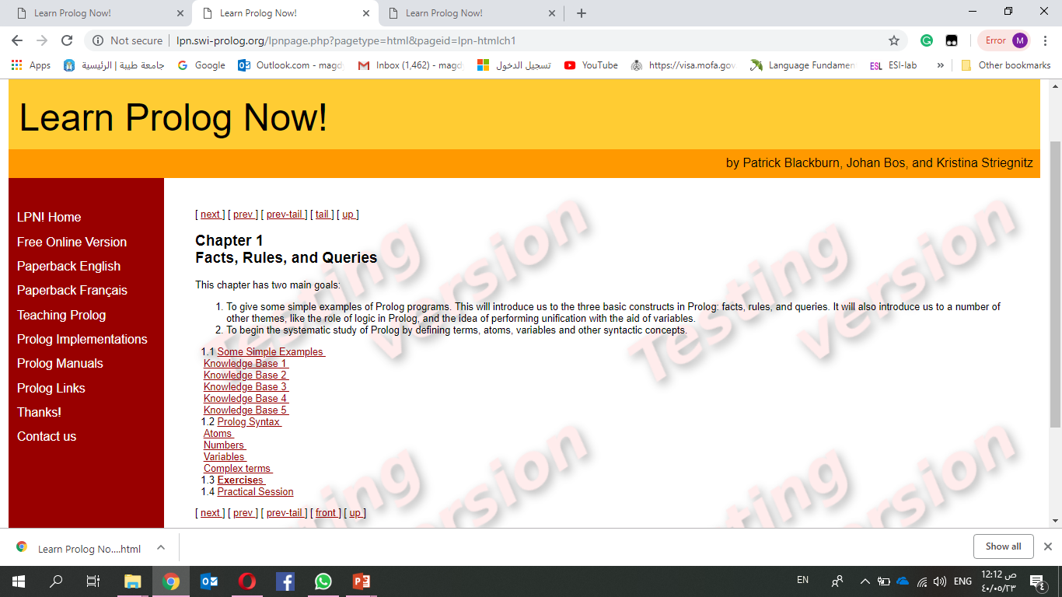
Exercises
Chapter 3,4

Slide 56
Summary of this lecture
In this lecture we introduced recursive predicates
We also looked at the differences between the declarative and the procedural meaning of Prolog programs
We have identified some of the shortcomings of Prolog seen as a logical programming language
In this lecture we introduced list and recursive predicates that work on lists
The kind of programming that these predicates illustrated is fundamental to Prolog
You will see that most Predicates you will write in your Prolog career will be variants of these predicates

